Slide 1


For Beginner
By :- RAHUL JOGRANA
www.dotnetlab.in
www.aspnetinhindi.blogspot.com
Twitter:- @thejograna
Github:- github.com/rahuljograna
Part 6 cards in ionic

Slide 2

Cards in ionic
Cards are a great way to display important pieces of content, and are quickly emerging as a core design pattern for apps
They are a great way to contain and organize information, while also setting up predictable expectations for the user.
With so much content to display at once, and often so little screen realestate, cards have fast become the design pattern of choice for many companies, including the likes of Google, Twitter, and Spotify.

Slide 3
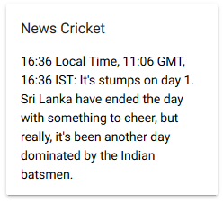
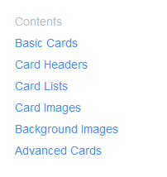
Cards in ionic

Slide 4
Let’s start

Slide 5
To learn new Technology along with Example like
ASP.NET, ASP.NET MVC, AngularJS, ASP.NET Web API
From Beginners visit my Youtube channel and steps and Source code is
Available on My Blog and Web site
To Get notification for new updates Subscribe my YOUTUBE Channel.
Source Code :- http://aspnetinhindi.blogspot.com
Website :- http://www.dotnetlab.in
Github :- https://github.com/rahuljograna
Twitter :- twitter.com/thejograna
Mail :- rahuljograna007@gmail.com
WhatsApp Number :- 9426585554

Slide 6
To Develop Application
Contact me
Mail me : rahuljograna007@gmail.com
Mobile : +91 9426585554
whatsApp : +91 9426585554

